Slide 1
VISUAL QUALITY CONTROL TOOL
IV Year B.Tech – Mini Project Review
Team Members Details
1. J. SWATHI - 21N31A6228
2. B. SAI LIKHITH - 21N31A6215
3. E. VISHAL - 21N31A6223
IV Year B.Tech – CSE (Cyber Security)
Under the Guidance of
Mrs. R . Annapurna
Assistant Professor
Department of CSE – Emerging Technologies

Slide 2
Outline
Abstract
Introduction
Existing System
Proposed System
Difference between Existing and Proposed
Literature Review
Architectural Diagram
Technical Requirements Specification
System Diagrams (UML Diagrams)
Test Cases
Output Screens
Results
References

Slide 3
Abstract
The project aim is to visual the data that is collected from different sources and check for the spikes and duplicates of the data and clean the data and use later for different modelling and other usage of the data.
Each and every minute nearly some millions of data has been generated and it is very difficult to check each record separately manually whether it is correct or not.
So, to solve this problem VQC tool is designed, and it helps to visualize the data graphically and can easily identify the spikes and duplicates of the data and can easily be removed and clean the data and use for future purposes.

Slide 4

Introduction
The VQC tool is an innovative solution designed to visualize data, enabling users to swiftly and effectively identify and rectify anomalies. By graphically representing the data, users can easily spot spikes—sudden and unexpected jumps in data values—and duplicates, ensuring that the dataset is clean and reliable for subsequent analysis and modeling.

Slide 5
Existing System
Excel is a widely used tool for data quality checking. It offers features like conditional formatting to identify duplicates, data validation to ensure accuracy, formula auditing to trace errors, and pivot tables/charts to profile the data.
Excel's filtering, sorting, and comparison functions can also help identify inconsistencies and outliers.
While Excel provides basic data quality control capabilities, it may struggle with large, complex datasets and lacks advanced visualization and automation features.

Slide 6
Proposed System
The VQC tool checks the data quality visually in the form of graphs. Pandas and NumPy is used for the data analysis purpose to create the data frames. We are using the Matplotlib to plot the graphs. And for the cleaning of data and also for the automation we use the Pandas and NumPy. And for the Graphical User Interface we used Tkinter.
Provides scalability.
Automation of data checking is done.
We can Flag the Data in the form of colors based on the spikes.

Slide 7
Existing vs Proposed System
The shift from Existing system towards the proposed VQC tool represents a transition from a more static, Excel-based approach to a more dynamic, technology-driven solution. This change aims to enhance data quality, increase efficiency, reduce time consuming, manual effort and provide more comprehensive and insightful data analysis capabilities, ultimately supporting better decision-making and data-driven strategies within the organization.
Existing system which has limited scalability compared to the Proposed system which can handle large data.

Slide 8
Literature Review
S. No | Paper Title, Authors & Publication Details | Algorithm/ Technique Used | Advantages | Limitations
1 | Handbook of Automated Data quality control and procedures of the National Data Buoy center by National Data Buoy center, stennis space center. | Automated Data quality control and procedures. | Graphical procedures, range limit and Automated procedures. | The metrics used to assess contractor performance could be more relevant and consistent.
2 | Handbook of Quality control procedures and methods for surface meteorology Data by Shawn R.smith j.parks camp and David M.legler | Quality control procedures and methods. | Guidance to end users by proposing quality assurance methods for meteorological information. | The comparison may have limitations due to varying observational systems.

Slide 9
Architecture Diagram or
System Diagram

Slide 10
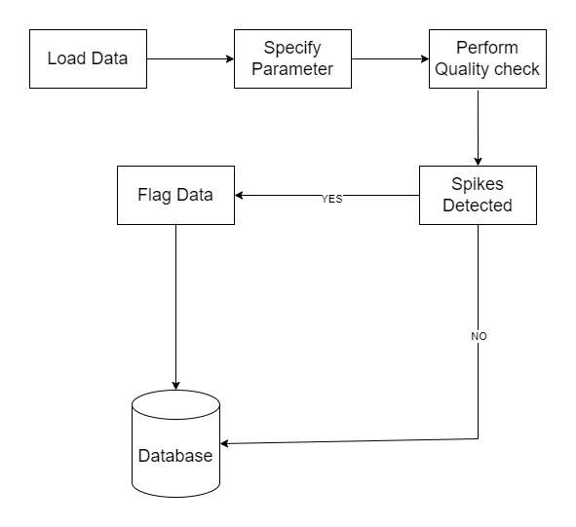
System Architecture

Slide 11
Technical Requirements Specifications

Slide 12
Software Requirement Specifications
FRONT-END &GUI
Tkinter
Python
Matplotlib
BACK-END/DATA PROCESSING
Pandas
NumPy

Slide 13
Hardware Requirement Specifications
Processor : Minimum intel i3
RAM : 4 GB
Hard disk : 256 GB

Slide 14
Application Modules
Module -1: User Interface Module
Module -2: Data Processing Module
Module -3: Data Visualization Module
Module -4: System Integration

Slide 15
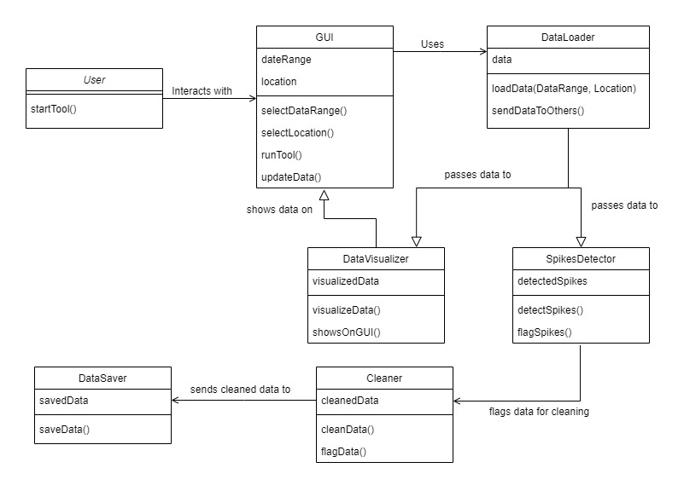
Class Diagram

Slide 16
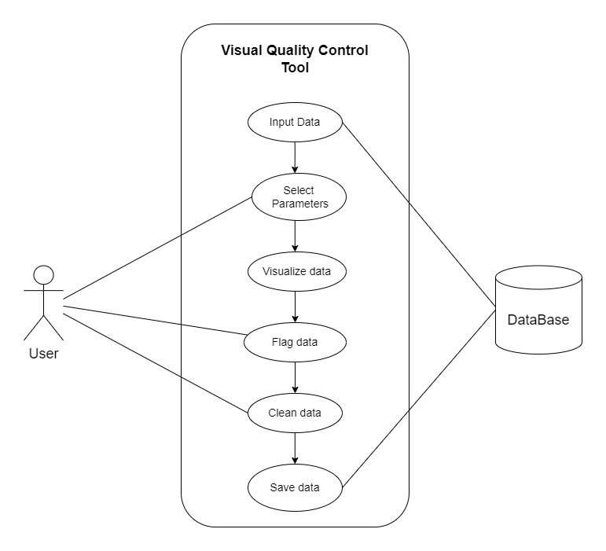
Use-Case Diagram

Slide 17
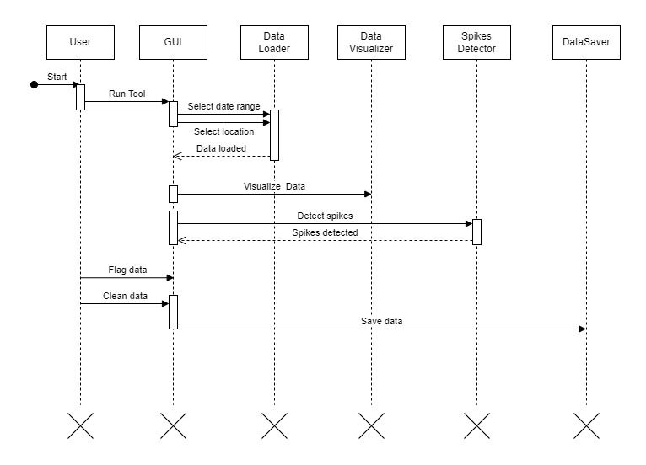
Sequence Diagram

Slide 18
About Visual Quality Control
Our application is about a Quality Control Tool with which we can perform quality checking on Big Data.
The VQC Tool Checks and controls the data in the plotting, it helps the analyst to understand the data easily whether it is good data or bad data.
By using this VQC tool the data analyst can save his time by checking the quality of data.

Slide 19
Testing and Test Cases
Test Case 1:
  Input: Selecting Dates that are out of range.
  Output: Graphs display misleading information or incorrect data.
Test Case 2:
  Input: Data file not uploaded.
  Output: Error! Input the Data file!
Test Case 3:
  Input: maindata.csv
  Output: Plotting of the graph is Successful.

Slide 20
Output Screens

Slide 21
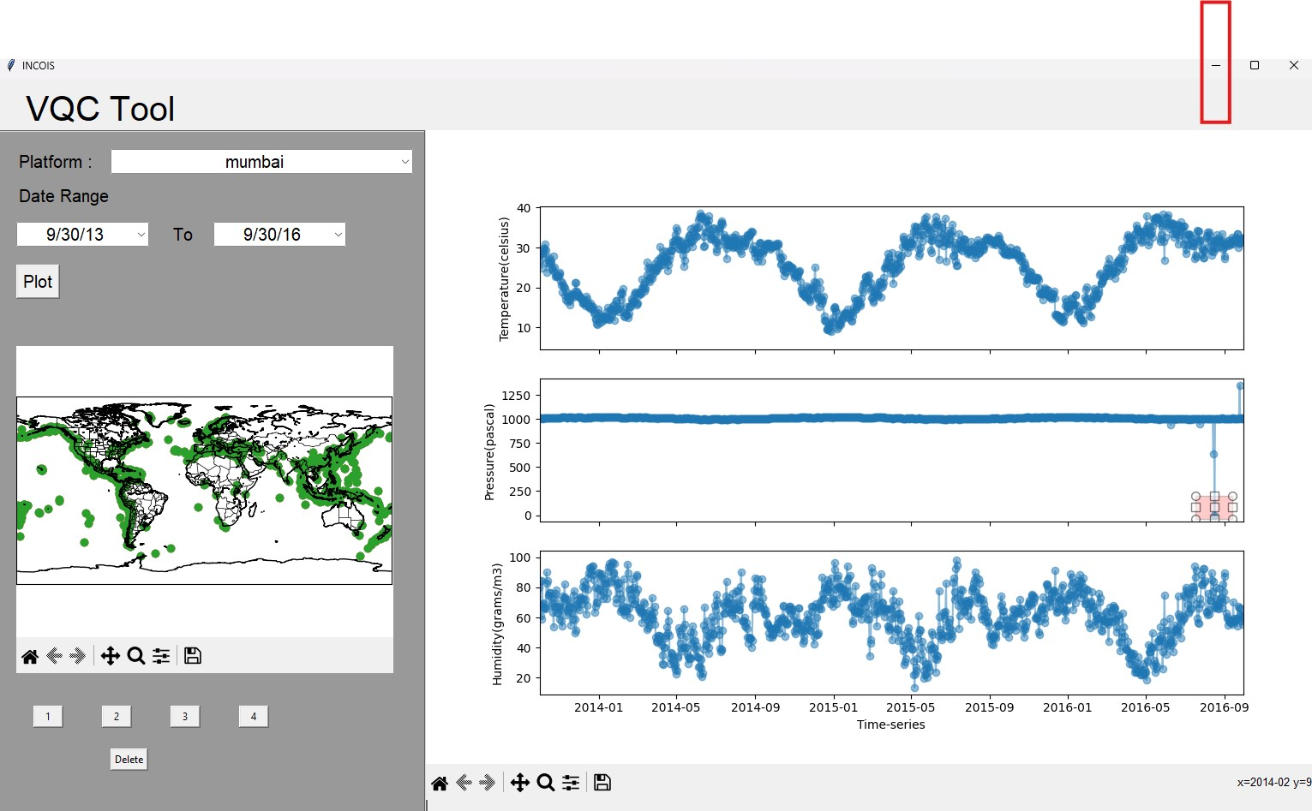
Output Screens

Slide 22
Results

Slide 23
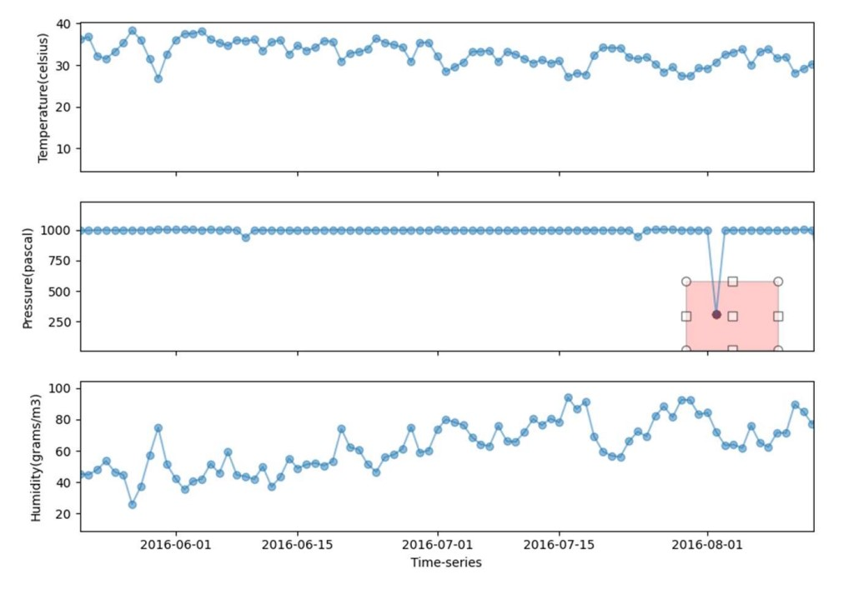
Results
Before:

Slide 24
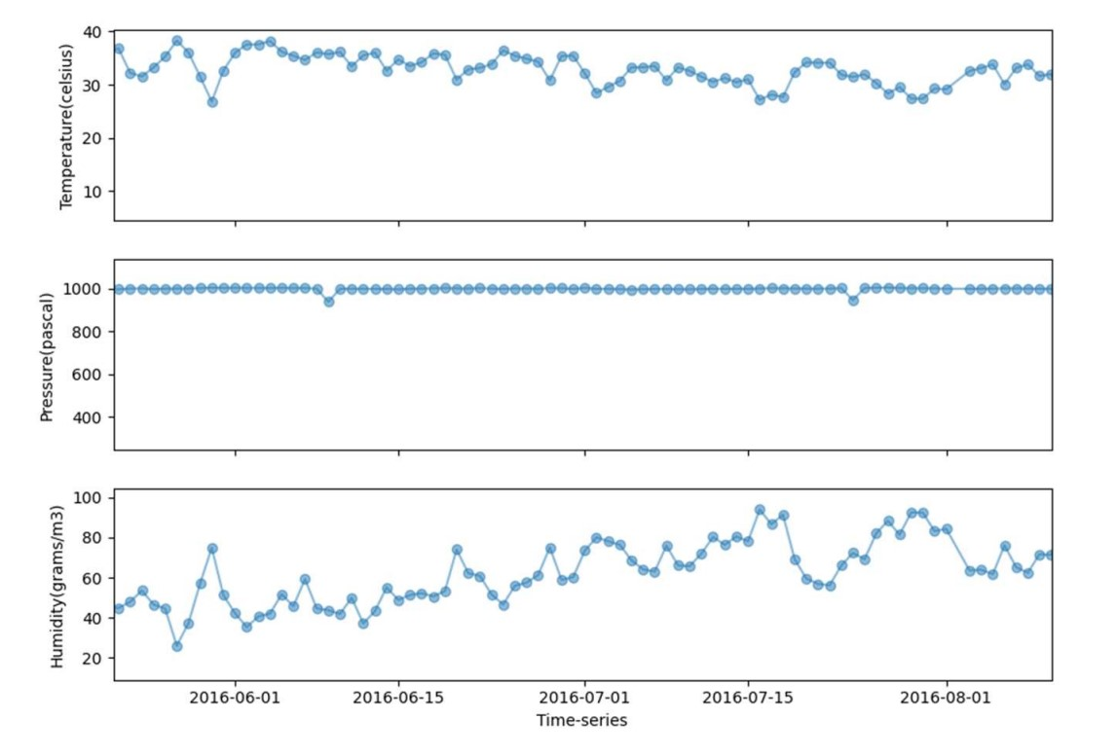
After:

Slide 25
References
Handbook of Automated Data quality control and procedures of the National Data Buoy center by National Data Buoy center, stennis space center, February 2003.
Handbook of Quality control procedures and methods for surface meteorology Data by Shawn Smith parks camp and David Legler, August 1996.
https://www.ndbc.noaa.govrealtime.html accessed on 28th November 2008.
https://www.pmel.noaa.govtaoprojover/qc.html accessed on 28th November 2008.

Slide 26
Thank you
1. J. SWATHI – 21N31A6228
2. B. SAI LIKHITH– 21N31A6215
3. E. VISHAL – 21N31A6223

